Slide 1
Solution for case assignment 1 (data modeling)
Champagne
(Case adapted from: https://www.champagne.fr/assets/files/economie/bulletin_expeditions_2018.pdf, https://stats.agriculture.gouv.fr/disar-saiku/?plugin=true&query=query/open/D_0021#query/open/D_0021)

Slide 2
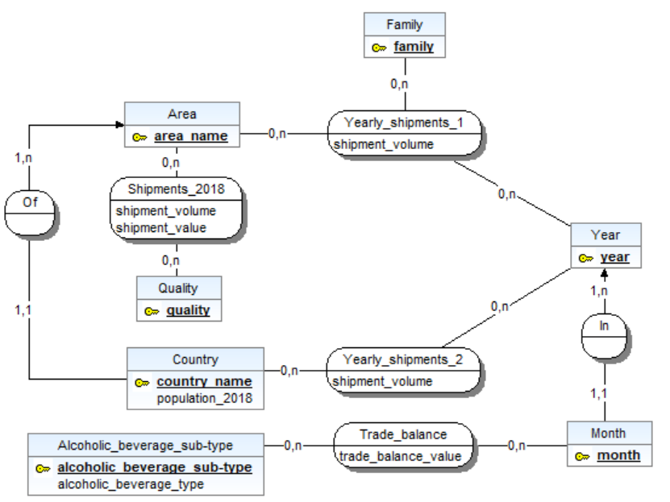
Conceptual entity-relationship (ER) schema in Win’Design (inverted cardinalities)

Slide 3
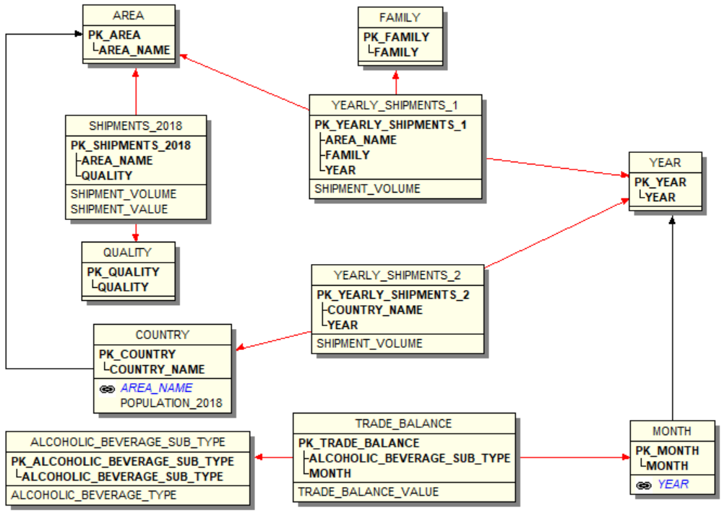
Logical snowflake schema
4 snowflakes. Facts:
Yearly_shipments_1
Yearly_shipments_2
Shipments_2018
Trade_balance

Slide 4
Worksheets in the physical Excel schema
Yearly_shipments_1
Yearly_shipments_2
Shipments_2018
Trade_balance
Country
Alcoholic_beverage_sub-type
(The other tables are not represented in the physical Excel database because they only have one attribute, their primary key. Note that in particular, the attribute year in Month is a time attribute computed from the month, so only the attribute month remains in table Month.)

